Slide 1

The Importance of eWIC Purchase Receipts
It is a requirement that the WIC Cardholder be provided a receipt showing details of the purchases. (Provision of the receipt is an FNS requirement and included in the NJ WIC Vendor Authorization Agreement.)
The receipt is verification that the purchase or void was completed as expected. The cashier must review the receipt to confirm accuracy of the transaction
The items the WIC cardholder is leaving the store with should always match the items listed as Purchased on the receipt
WIC Cardholders are trained at their WIC Local Agency to save their last eWIC receipt to keep track of their remaining balance. This will assist in their next shopping trip.
If ever there is a need for a dispute resolution from the Cardholder or the Vendor, the receipt is required as documentation of what error may have occurred

Slide 2
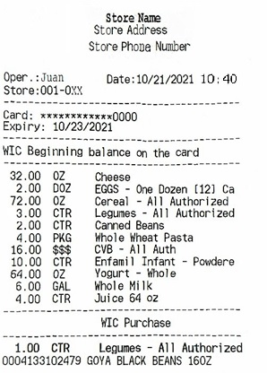
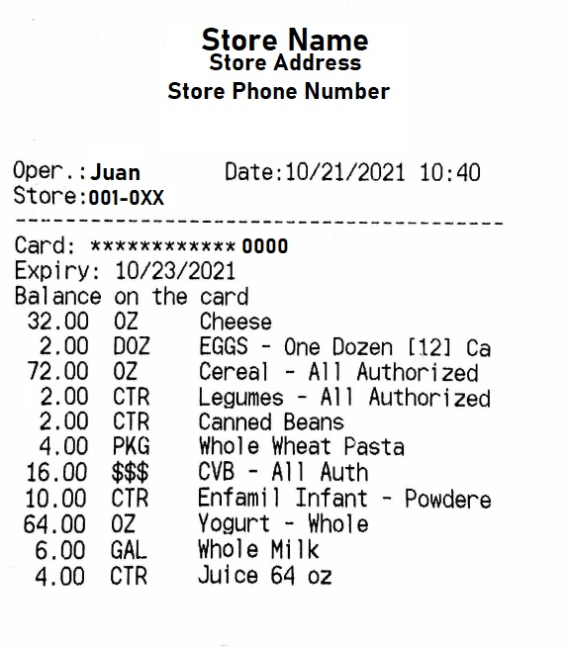

KeyPoints of eWIC Transaction Receipts
  *It is important to know the WIC Beginning Balance because if an item is not listed or the quantity is less than the WIC Cardholder wants to buy, they will not be able to do so.
  *The WIC Cardholder should always leave the store with what is listed here for the WIC Purchase.
  *The WIC Cardholders are encouraged to keep the Remaining Balance Receipt, so they know what is the remaining balance in their account.

